Slide 1
Inventory Management System
Nathaniel Inman Michael Stowe Terry Kleoppel Lucas Gillespie

Slide 2
Terry’s slides are after this slide
Terry covers Purpose, GUI, & How to use it

Slide 3
Purpose
To create a software to contain all the inventory of the client.
To help personnel by including informative descriptions for each item
To keep track of other information related to stock, such as royalties and vendors

Slide 4
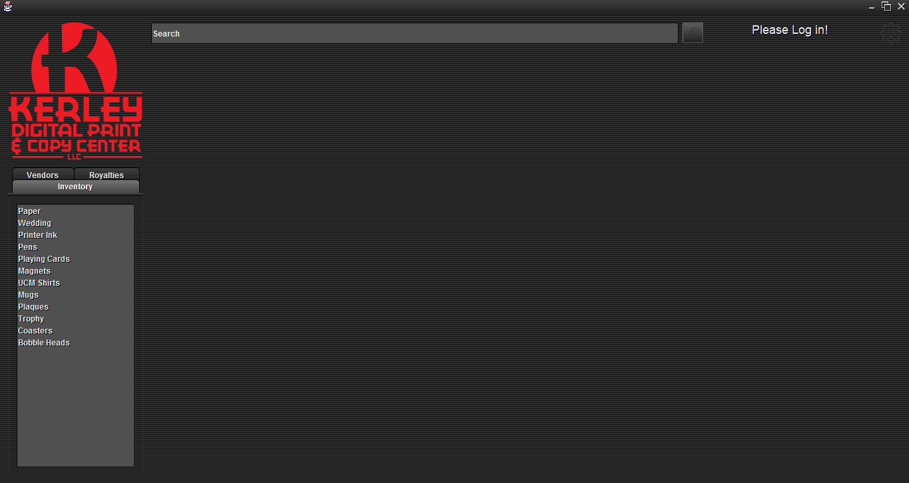
GUI
Notes:
“Gear menu contains Log in, View Users, Add Inventory, Vendor, Royalty, and User Buttons”

Slide 5
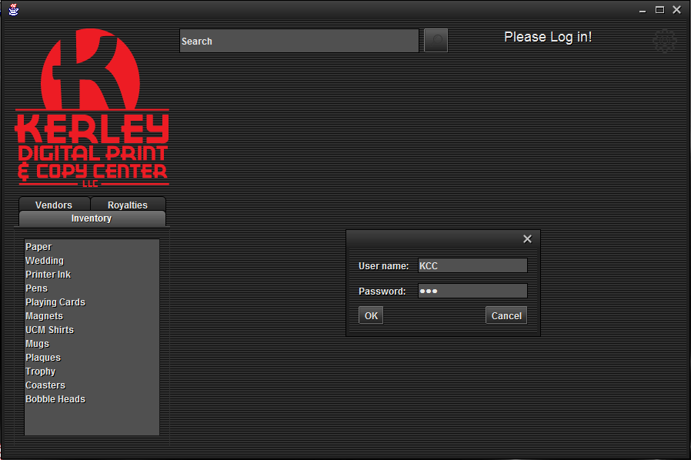
Logging In

Slide 6
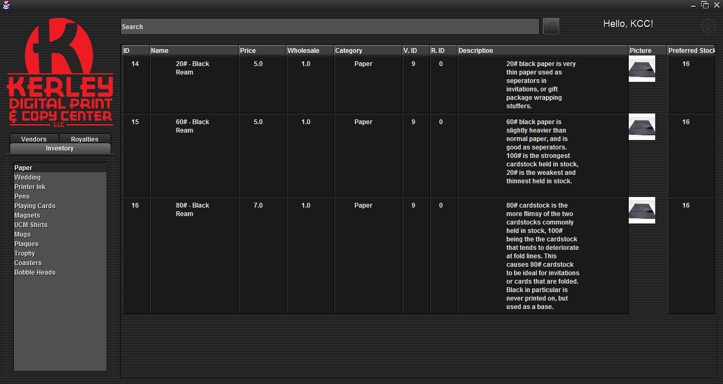
Categories

Slide 7
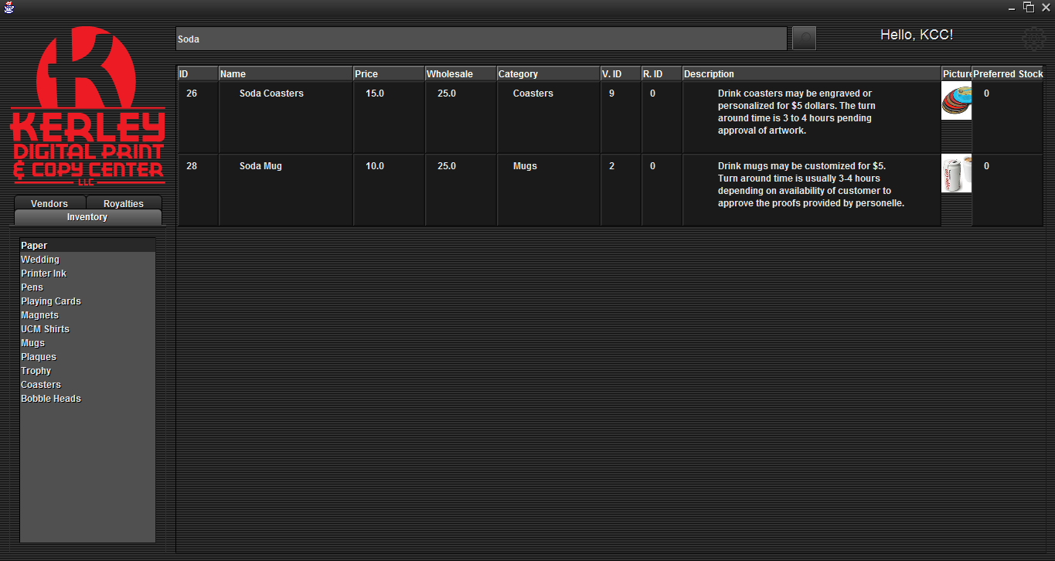
Search

Slide 8
Mike’s slides go after this one
Mike covers: How it Works, and components

Slide 9
Basic Functionality
User sends input to GUI
GUI sends input to database
Database sends output to GUI
GUI sends output to user
Notes:
“In the simplest terms, this is what our software does. We’ll go into more detail later.”

Slide 10
javax.swing
Standard library of lightweight display components
Easily define layouts and add components
Notes:
“You’re all probably familiar with this already.”

Slide 11
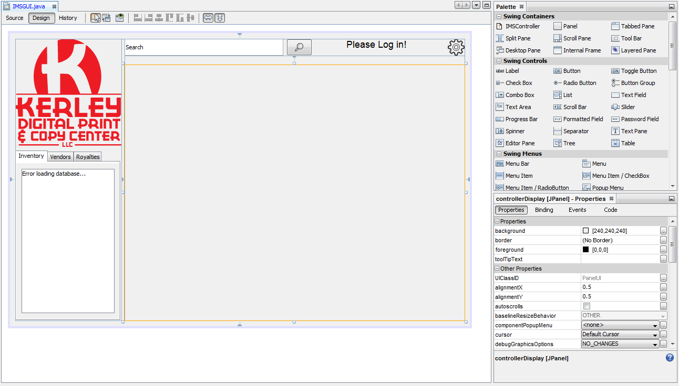
Our Design
Notes:
“This is the NetBeans GUI editor. We were able to design this in a WYSIWYG environment. The highlighted pane is where our main controller class will go, which uses handwritten code.”

Slide 12
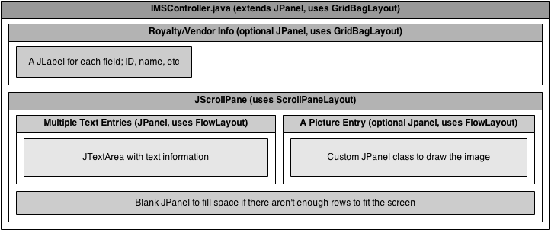
Our Design
Notes:
I’m just going to briefly explain everything here.

Slide 13
Implementation Challenges
We had to write our own text wrapping function
We had to make a custom JPanel class for images
The subtle differences between classes such as JLabel, JTextPane, and JTextArea, as well as between different layout options, caused confusion
Notes:
I’m just going to briefly go over some of the things that gave us (me) the most trouble.

Slide 14
Lucas’s slides go after this
Lucas covers Architecture, predominately UML diagram’s and some descriptions

Slide 15
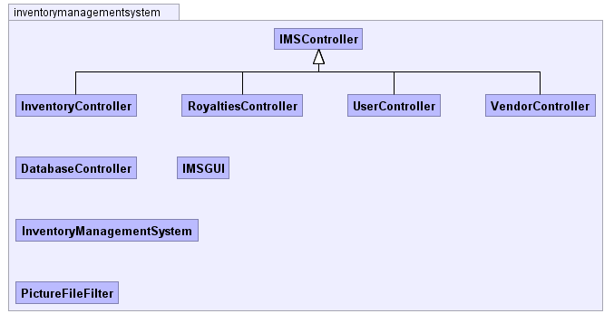
Structure

Slide 16
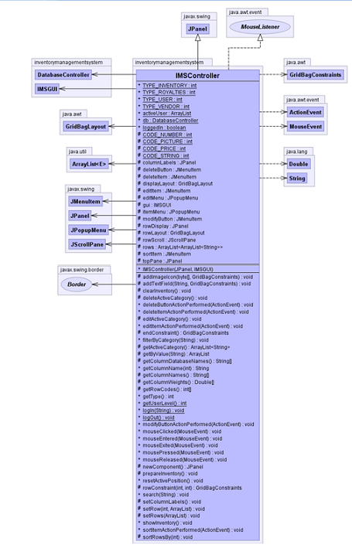
IMSController
What does it do?
IMSController is the base class that other controllers will extend to.
Gives permissions to users. Depending on the level the user has he/she can modify data.
Sorting Algorithm and Search functions are in this class.

Slide 17
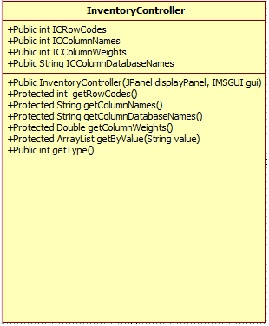
InventoryController
What does it do?
It controls the main aspects of an inventory.
InventoryController gets the ID, Name, Price, Wholesale, Category, Vendor ID, Royalty ID, Description, Picture, and Preferred Stock,

Slide 18
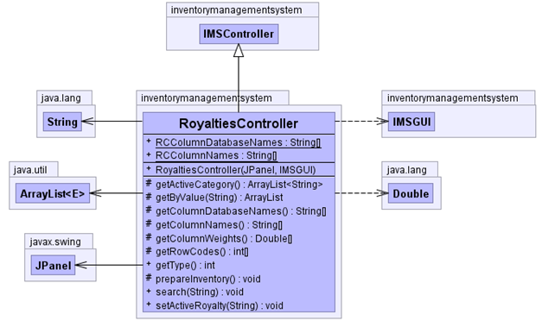
RoyaltiesController
What does it do?
RoyaltiesController manages the royalties .
RoyaltiesController has a gets Royalties: ID, Name, Phone Number , Ext, Addresses , Website, E-mail, PPOC, Royalties.

Slide 19
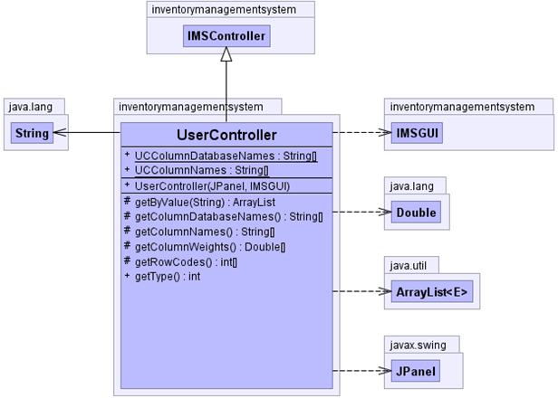
UserController
What does it do?
User Controller is used predominately for creating new users and changing login credentials.
UserController methods are gets Users: ID, User Name, Password, Level.

Slide 20
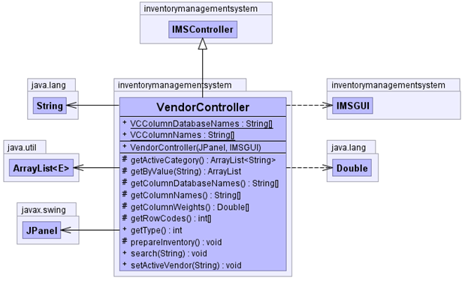
VendorController
What does it do?
VendorController manages Vendors.
VendorController shows items that vendors sells.
VendorController is similar to RoyaltiesController. Except it doesn’t have get Royalties.

Slide 21
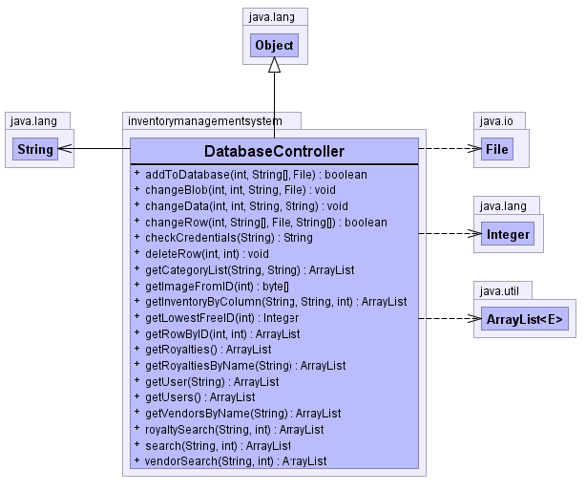
DatabaseController
What does it do?
DatabaseController purpose is to establish connections with the database. Makes the data viewable for the Controllers.
DatabaseController has a way to retrieve data stored in Database such as: Inventory, Royalties, Users, Vendors.

Slide 22
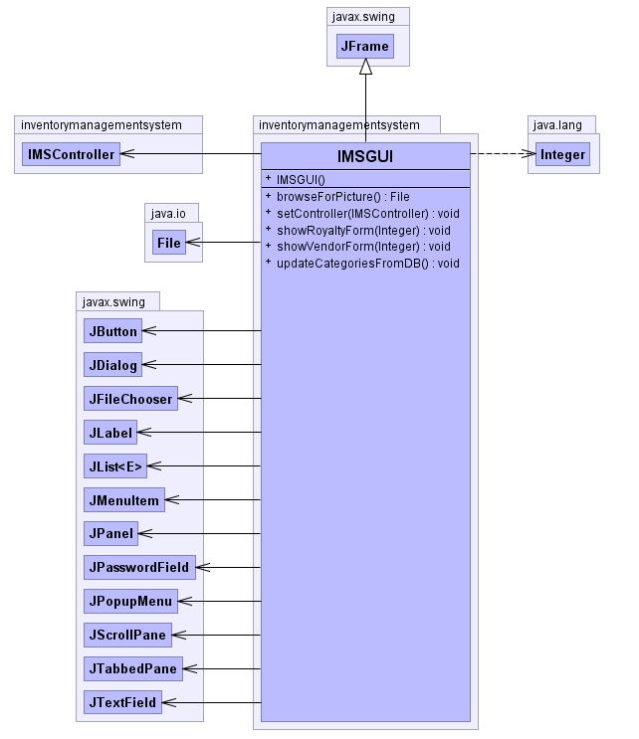
IMSGUI
What does it do?
It provides an graphical user interface.
Contains all the graphical design components
Small with a handful of items
.

Slide 23
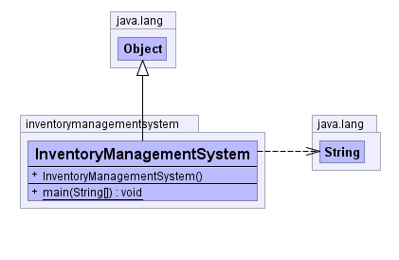
InventoryManagementSystem
What does it do?
It is the main hub from where everything is connected.
Provides the main scope.
Dictates class distribution.
.

Slide 24
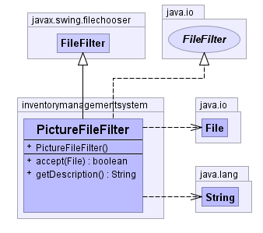
PictureFileFilter
What does it do?
Makes it easier for the user to which file they want to upload for the picture of the inventory item that they are creating.
It browses users systems.

Slide 25
Nathan’s slides go after this
Nathan covers architecture p2 and future plans

Slide 26
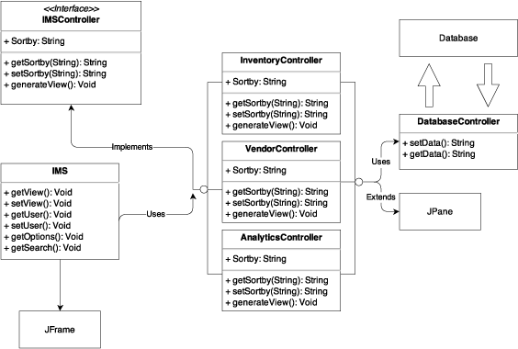
Model View Controller

Slide 27
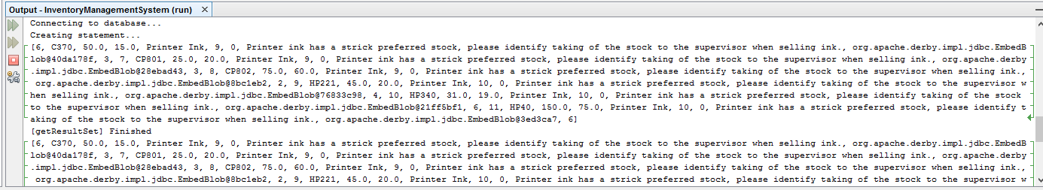
Debugging

Slide 28
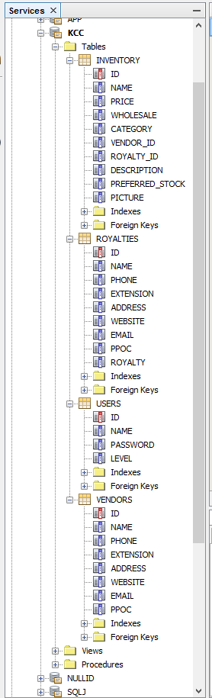
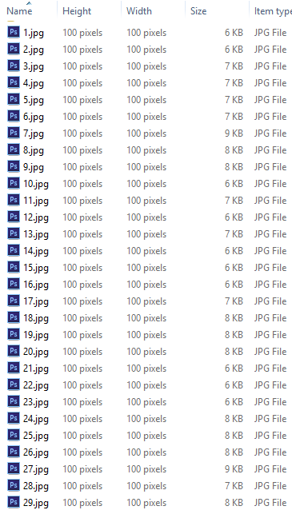
Data

Slide 29
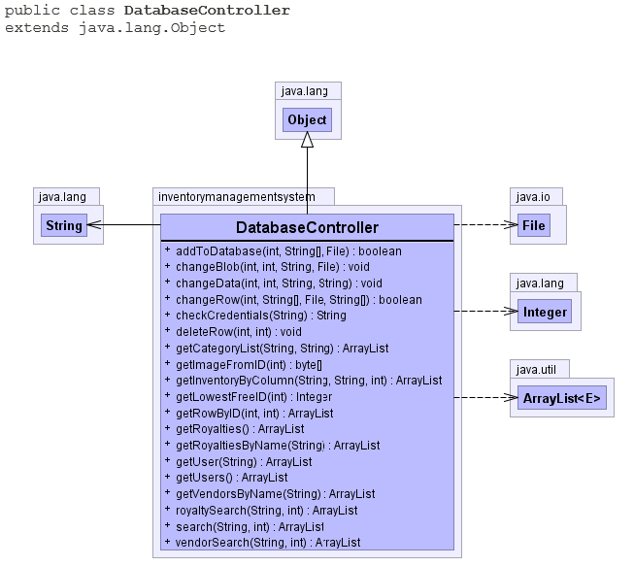
Database Controller

Slide 30
Unit & Integration Testing

Slide 31
References
https://www.draw.io – UML Diagram system used for DD
yWorks Doclet – Auto-documentation system designed for Java
www.gradle.org – Automated Unit Testing Environment
Pegdown Doclet project - Replaces comments with Markdown
http://creativecommons.org/licenses/by/3.0/ - Creative Commons License for Linecons Free – Vector Icons Pack by Designmodo

